Slide 1
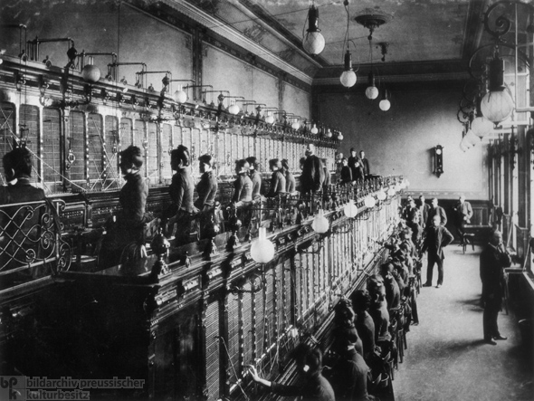
Industrialization 1865-1898

Slide 2
Industrialization
Railroads
New Inventions
Monopolies
Labor Unions
Is the Gilded Age an apt description for this time period? Why or Why Not? Cite at least 2 specific pieces of evidence.

Slide 3
Expansion of Industry
After Civil War, U.S. was largely agricultural
By 1920, the U.S. was the leading industrial power in the world
This enormous growth was due to three factors;
1) Natural Resources
2) Governmental support
3) Urbanization

Slide 4
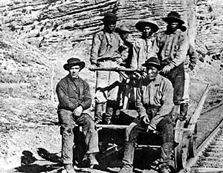
Transcontinental Railroad
Completed in 1869
Workforce was largely immigrants from China and Ireland
Thousands lost their lives and tens of thousands were injured laying track
Government will violate treaties with Native Americans in order to gain land in the West for RR and settlers.

Slide 5
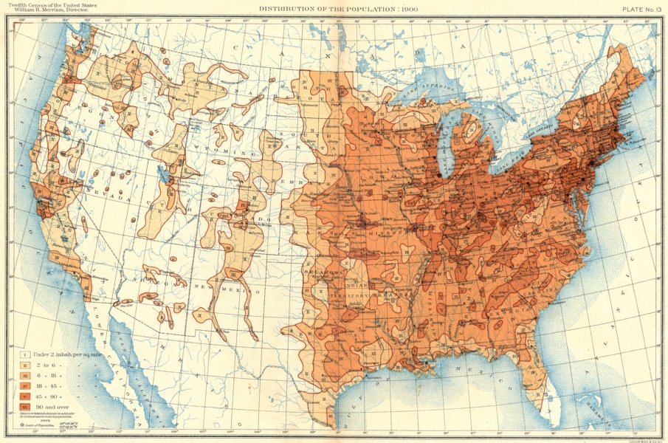
Railroads Spur Other Industries
The rapid growth of the railroad industry influenced the iron, coal, steel, lumber, and glass businesses as they tried to keep up with the railroads demand for materials
The spread of the railroads also led to the growth of towns, new markets, and opportunity for profiteers

Slide 6
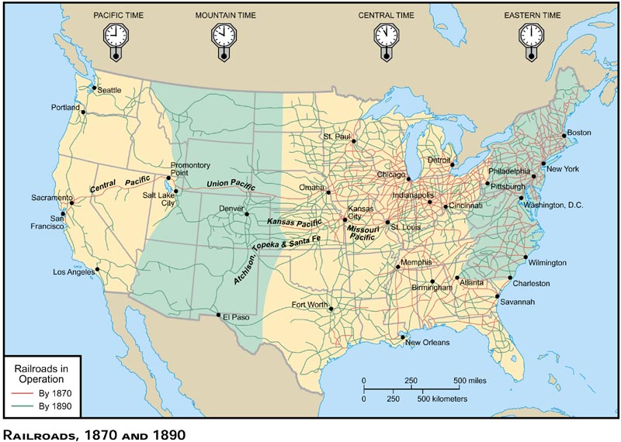
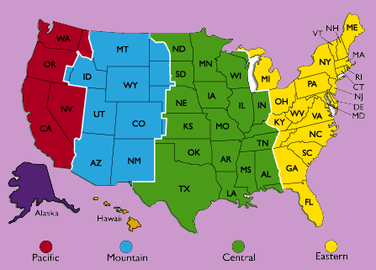

Slide 7
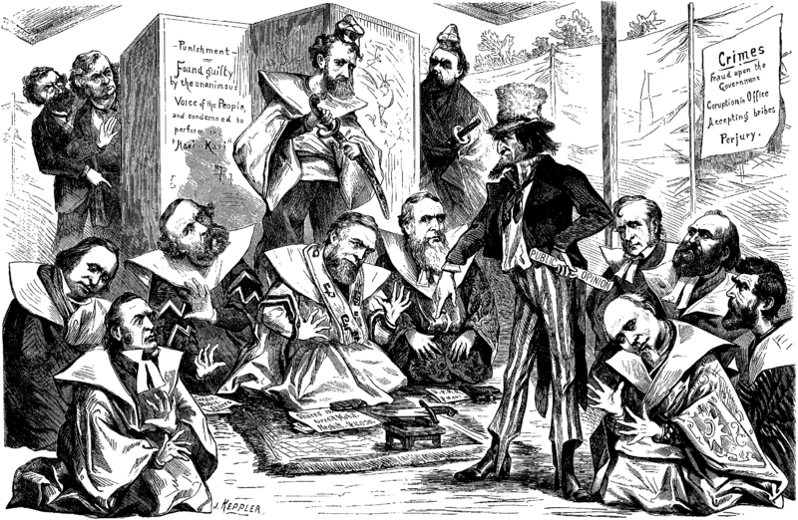
Credit Mobiliér Scandal
Stockholders of Union Pacific Railroad formed a construction company in 1864
Stockholders then gave contracts to the company to lay track at 3 times the actual costs and pocketed the difference
They donated shares of the stock to 20 Republican members of Congress in 1867

Slide 8
Ending Scandal and Graft
Farmers were especially affected by corruption in the railroad industry
Grangers (a farmers organization) protested land deals, price fixing, and charging different rates to different customers
Granger Laws were then passed protecting farmers
States were given regulation control of railroads through the Interstate Commerce Act—attempt to end corruption in the RR

Slide 9
Discussion Question
How does Railroad and Corruption inform the question: Is the Gilded Age an apt description for this time period? Why or Why Not?

Slide 10
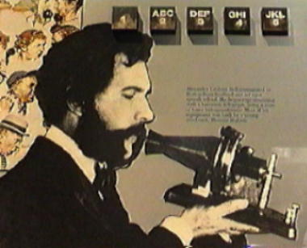
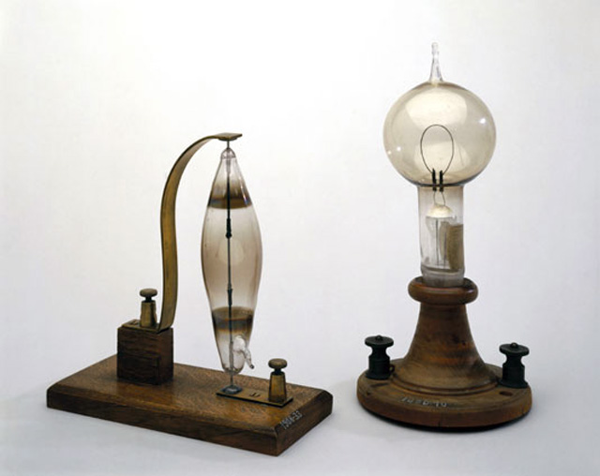
Inventions Spur Industry
Incandescent light bulb-1880 by Thomas Edison
Later produced a system for producing and distributing electricity
Typewriter-1867 by Christopher Sholes
Opened up new jobs for women (5% in 1870 to 40% in 1910)
Telephone-1876 by Alexander Graham Bell

Slide 11
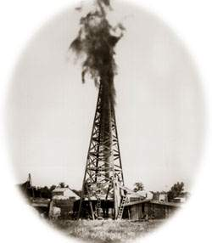
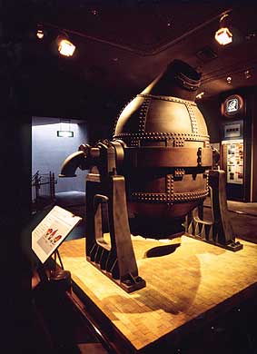
Boom in Industry
Oil Boom—oil drilling began on a large scale with the use of the steam engine
Bessemer Steel Process—conversion of iron into steel by taking out carbon

Slide 12
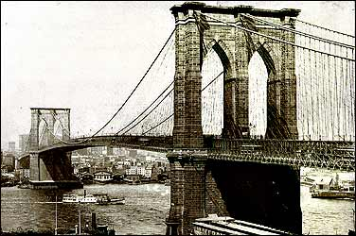
New Uses for Steel
Railroads were largest customers for steel
Others: barbed wire, farm equipment, bridges, and first skyscrapers.

Slide 13
Discussion Question
How do new inventions inform the question: Is the Gilded Age an apt description for this time period? Why or Why Not?

Slide 14
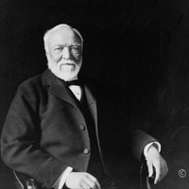
Age of Robber Barons
Andrew Carnegie
One of the first industrialists
By 1899, Carnegie Steel Company manufactured more steel than all of Great Britain
Found new ways to make steel more cheaply
Wanted to control as much of the steel industry as possible
Gospel of Wealth—Philanthropy

Slide 15
Monopolies
Monopoly—complete control over an industry
Vertical integration—bought out suppliers, transportation lines, and factories
Horizontal Integration—Bought up the competition through friendly and hostile takeovers
Monopolies determine prices for goods, and since they are the only one producing the good, they can charge whatever price they want.

Slide 16
Business Growth
Company mergers could result in a monopoly (Trust)
Consolidation and Mergers
Rockefeller Standard Oil Company
2% of crude oil in 1870
90% of crude oil in 1880

Slide 17
SHERMAN ANTI-TRUST ACT
In 1890, the Sherman Anti-Trust Act made it illegal to form a monopoly (Trust)
Prosecuting companies under the Act was not easy – a business would simply reorganize into single companies to avoid prosecution
Seven of eight cases brought before the Supreme Court were thrown out

Slide 18
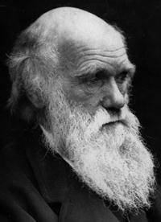
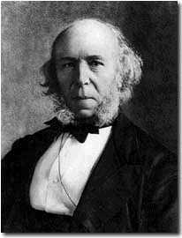
SOCIAL DARWINISM
The philosophy known as Social Darwinism has its origins in Darwin’s theory of evolution
Darwin theorized that some individuals in a species flourish and pass their traits on while others do not
Social Darwinists (like Herbert Spencer) believed riches was a sign of God’s favor, and being poor was a sign of inferiority and laziness
DARWIN (RIGHT) LIMITED HIS FINDINGS TO THE ANIMAL WORLD
SPENCER WAS THE ONE WHO COINED THE PHRASE “SURVIVAL OF THE FITTEST”

Slide 19
Discussion Question
How do Capitalists and Social Darwinism inform the question: Is the Gilded Age an apt description for this time period? Why or Why Not?

Slide 20
Emergence of Labor Unions
Workers had very poor working conditions
6 or 7 days a week, no sick leave, no compensation for injuries
1882, average of 675 workers killed per week
Workers realized that they needed to organize in order to fight for better wages and working conditions.
First union was the National Labor Union in 1866
Knights of Labor (Radical)
American Federation of Labor—Craft Union (Samuel Gompers)
Industry Specific Unions—American Railway Union (Eugene V. Debs)
Industrial Workers of the World (Eugene V. Debs)

Slide 21
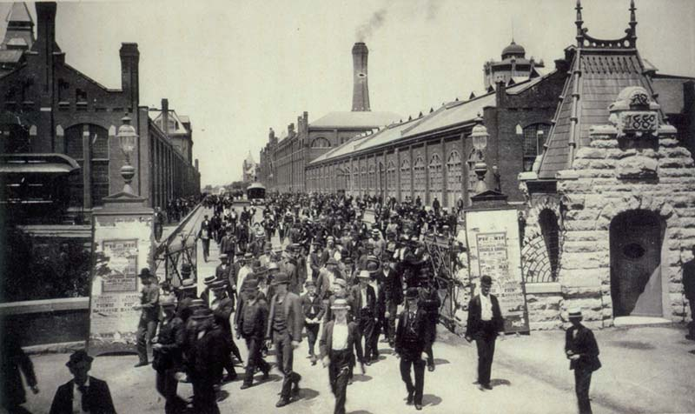
Workers and Strikes
Pullman Palace Car Company
A railroad car factory in Illinois
Created a town to house workers (Pullman) supposed to be like a “Utopia”
Pullman workers felt town too strict
Pullman lowered wages to cut cost, but not rent in town—led to a violent strike in 1894
Notes:
30 strikers killed when Grover Cleveland stepped in and sent strikebreakers to end the strike and start up railway traffic

Slide 22
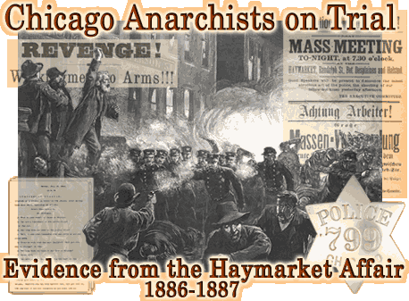
Haymarket Affair
Labor leaders continued to push for change – and on May 4, 1886 3,000 people gathered at Chicago’s Haymarket Square to protest police treatment of striking workers
A bomb exploded near the police line – killing 7 cops and several workers
Radicals were rounded up and executed for the crime
Blamed on Knights of Labor

Slide 23
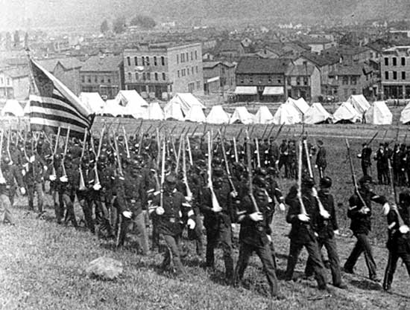
Homestead Strike
Even Andrew Carnegie could not escape a workers strike
Conditions and wages were not satisfactory in his Steel plant in Pennsylvania and workers struck in 1892
Carnegie hired Pinkerton Detectives to guard the plant and allow scabs to work
Detectives and strikers clashed – 3 detectives and 9 strikers died
The National guard restored order – workers returned to work

Slide 24
Discussion Question
How do labor unions and strikes inform the question: Is the Gilded Age an apt description for this time period? Why or Why Not?

Slide 25
Industry
Railroads
New Inventions
Monopolies
Labor Unions and Strikes
Is the Gilded Age an apt description for this time period? Why or Why Not? Cite at least 2 specific pieces of evidence.

